Slide 1



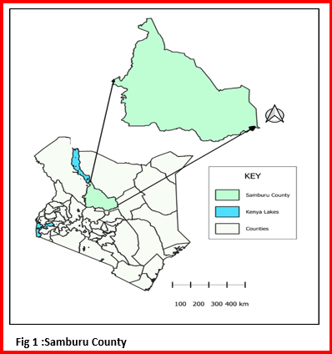
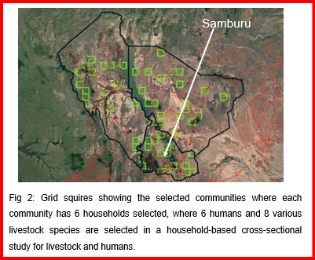
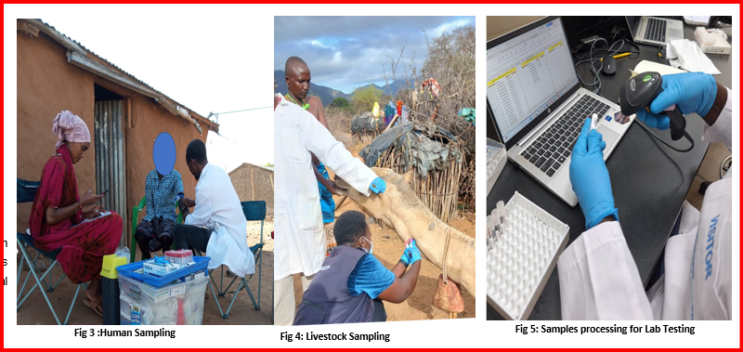
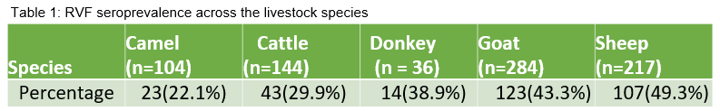
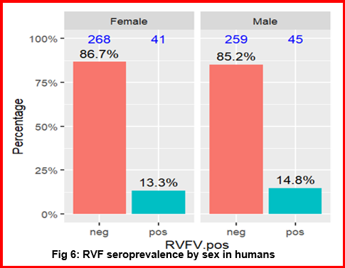




Serological evidence and risk factors of Rift Valley Fever in apparently healthy livestock and humans in a medium-risk region of Kenya
J. Akale¹, M. Owiny¹, A. Mwatodo¹, M. Muturi², D. Nthiwa³, J. Hassell⁴,E. Ferve⁴
1. Kenya Field Epidemiology and Laboratory Training Programe (KFELTP), 2. Directorate of Veterinary Services (DVS), 3. International Livestock Research Institute (ILRI), 4. Smithsonian Institution - USA
BACKGROUND
Rift Valley Fever Virus (RVFV) is a zoonotic arbovirus of major public health and economic importance.
The impact is significant, especially in pastoral communities with intense human-animal-environmental interactions.
This study investigated the seroprevalence and risk factors for Rift Valley Fever (RVF) human and livestock.
OBJECTIVE: To determine the seroprevalence and associated risk factors of Rift Valley Fever Virus in humans and livestock in Samburu.
METHODOLOGY: A cross-sectional design was used to sample humans and livestock.
A questionnaire administered to identified household heads/individuals to collect epidemiological data on risk factors for RVFV exposure.
STUDY AREA:
Samburu, Kenya
STUDY DESIGN AND SAMPLING
Household selection Human and livestock sampling, and Laboratory processing
Samburu
STATISTICAL ANALYSIS:
RESULTS:
Prevalence:
Human n = 613,86 (14.0%)
Livestock n=785,310 (39.5%)
DISCUSSION:
Human proximity to stagnant water was associated with RVF seropositivity
RVF was sero prevalent in human and livestock
Cumulative exposures increased with age in livestock and in humans
Sheep and goats had higher RVF seropositivity than other species
2. Risk factors
Table 2: Variables substantially associated with the RVF positivity in livestock and humans compared to the reference groups using Multivariable Bayesian Model
Variables and categories | Mean | Mean | l-95% CI | u-95% CI | u-95% CI
Livestock Species
Sheep | (Ref.)
Goats | -0.19 |  | -0.57 |  | 0.2
Cattle | *-0.73 |  | -1.21 |  | -0.27
Camel | *-1.18 |  | -1.78 |  | -0.58
Donkey | -0.57 |  | -1.38 |  | 0.19
Livestock Age
Adult | (Ref.)
Calffoalkidlamb | *-0.76 |  | -1.21 |  | -0.31
Subadultyearling | *-0.44 |  | -0.88 |  | -0.01
Human Age
<21years | (Ref.)
>60 years | *0.86 |  | 0.51 |  | 1.23
Contact with stagnant water
No | (Ref.)
Yes | *1.94 |  | 0.31 |  | 3.93
CONCLUSIONS
RVFV is actively circulating in both humans and livestock in Samburu County
The results shows that RVF could be endemic rather than Epidemic as it has been known
Risk communication is recommended
Need for targeted prevention and control through one health approach
* Variables associated with RVF positivity
Contact: akalejane@gmail.com

